Slide 2
ECAC Meeting Agenda
Introduction of the Preschool Team
Early Childhood Advisory Council (ECAC)
Purpose
Stakeholders/Partners
Meeting Schedule
Communication
Life in Preschool
Administrative Updates
Team Penguin!
Next Meeting and Exit Ticket

Slide 3
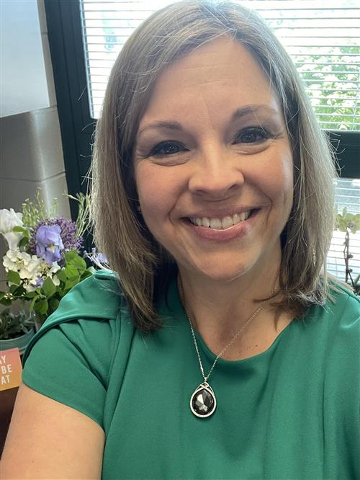
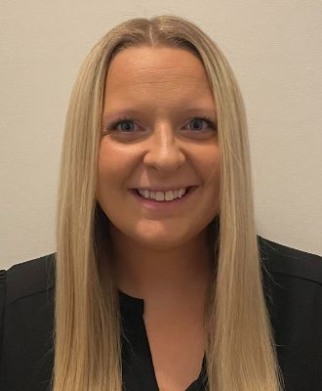
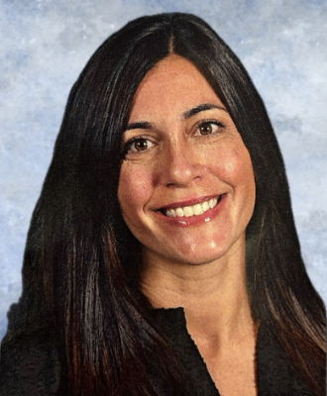
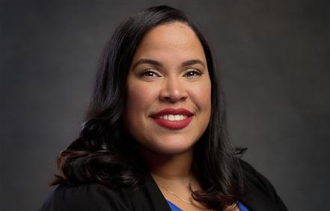
Dr. Kari McGann Superintendent of Flemington-Raritan School District
Dr. Danielle Hamblin Director of Pupil Personnel Services & Special Education
Amanda Cahill Supervisor of Early Childhood Education
Nicole Bateman Preschool Instruction Coach (PIC) and Intervention and Referral Specialist
Katherinne Javier-Mannino Community and Parent Involvement Specialist (CPIS) for Preschool and Administrative Assistant

Slide 4
What is ECAC?
Early childhood advisory council or “ECAC” means an advisory group of community stakeholders interested in the education and welfare of children in preschool through grade three that is convened by the school district (N.J.A.C.6A:13A-1.2).
Members: Community and Parent Involvement Specialist (CPIS), School Personnel, Parents, Community Stakeholders, and Early Childhood Providers as applicable
Meetings: Quarterly

Slide 5
Communication
How can the FRSD Preschool program support our community?
Communication Efforts
Feedback on our Preschool Website: Is there any additional information that would be beneficial to add to the website?
Community Involvement
Informational Resources
Communication Needs Assessment

Slide 6
Community Needs Assessment (CNA)
Main Focus of the Assessment - Community input is essential to ensure that the needs of our community are served within the scope of early childhood education
Purpose: To identify family challenges which can be supported by preschool staff, to inform 2024-2025 Preschool Goals, aligned with the mission of ECAC to serve our children and families of FRSD by facilitating and sustaining collaboration while ensuring success for all children. Some topics included in the CNA are as follows:
-Health -Mental Health
-Self-Regulation -Bedtime
-Challenging Behaviors -Establishing Routines
-Nutrition -Screen time
-Potty Training -Speech and Language
NEXT STEPS: CNA Google Form will be sent via email to 2024-2025 registered preschool students annually
*Parent workshops will be planned inclusive of CNA results.

Slide 7
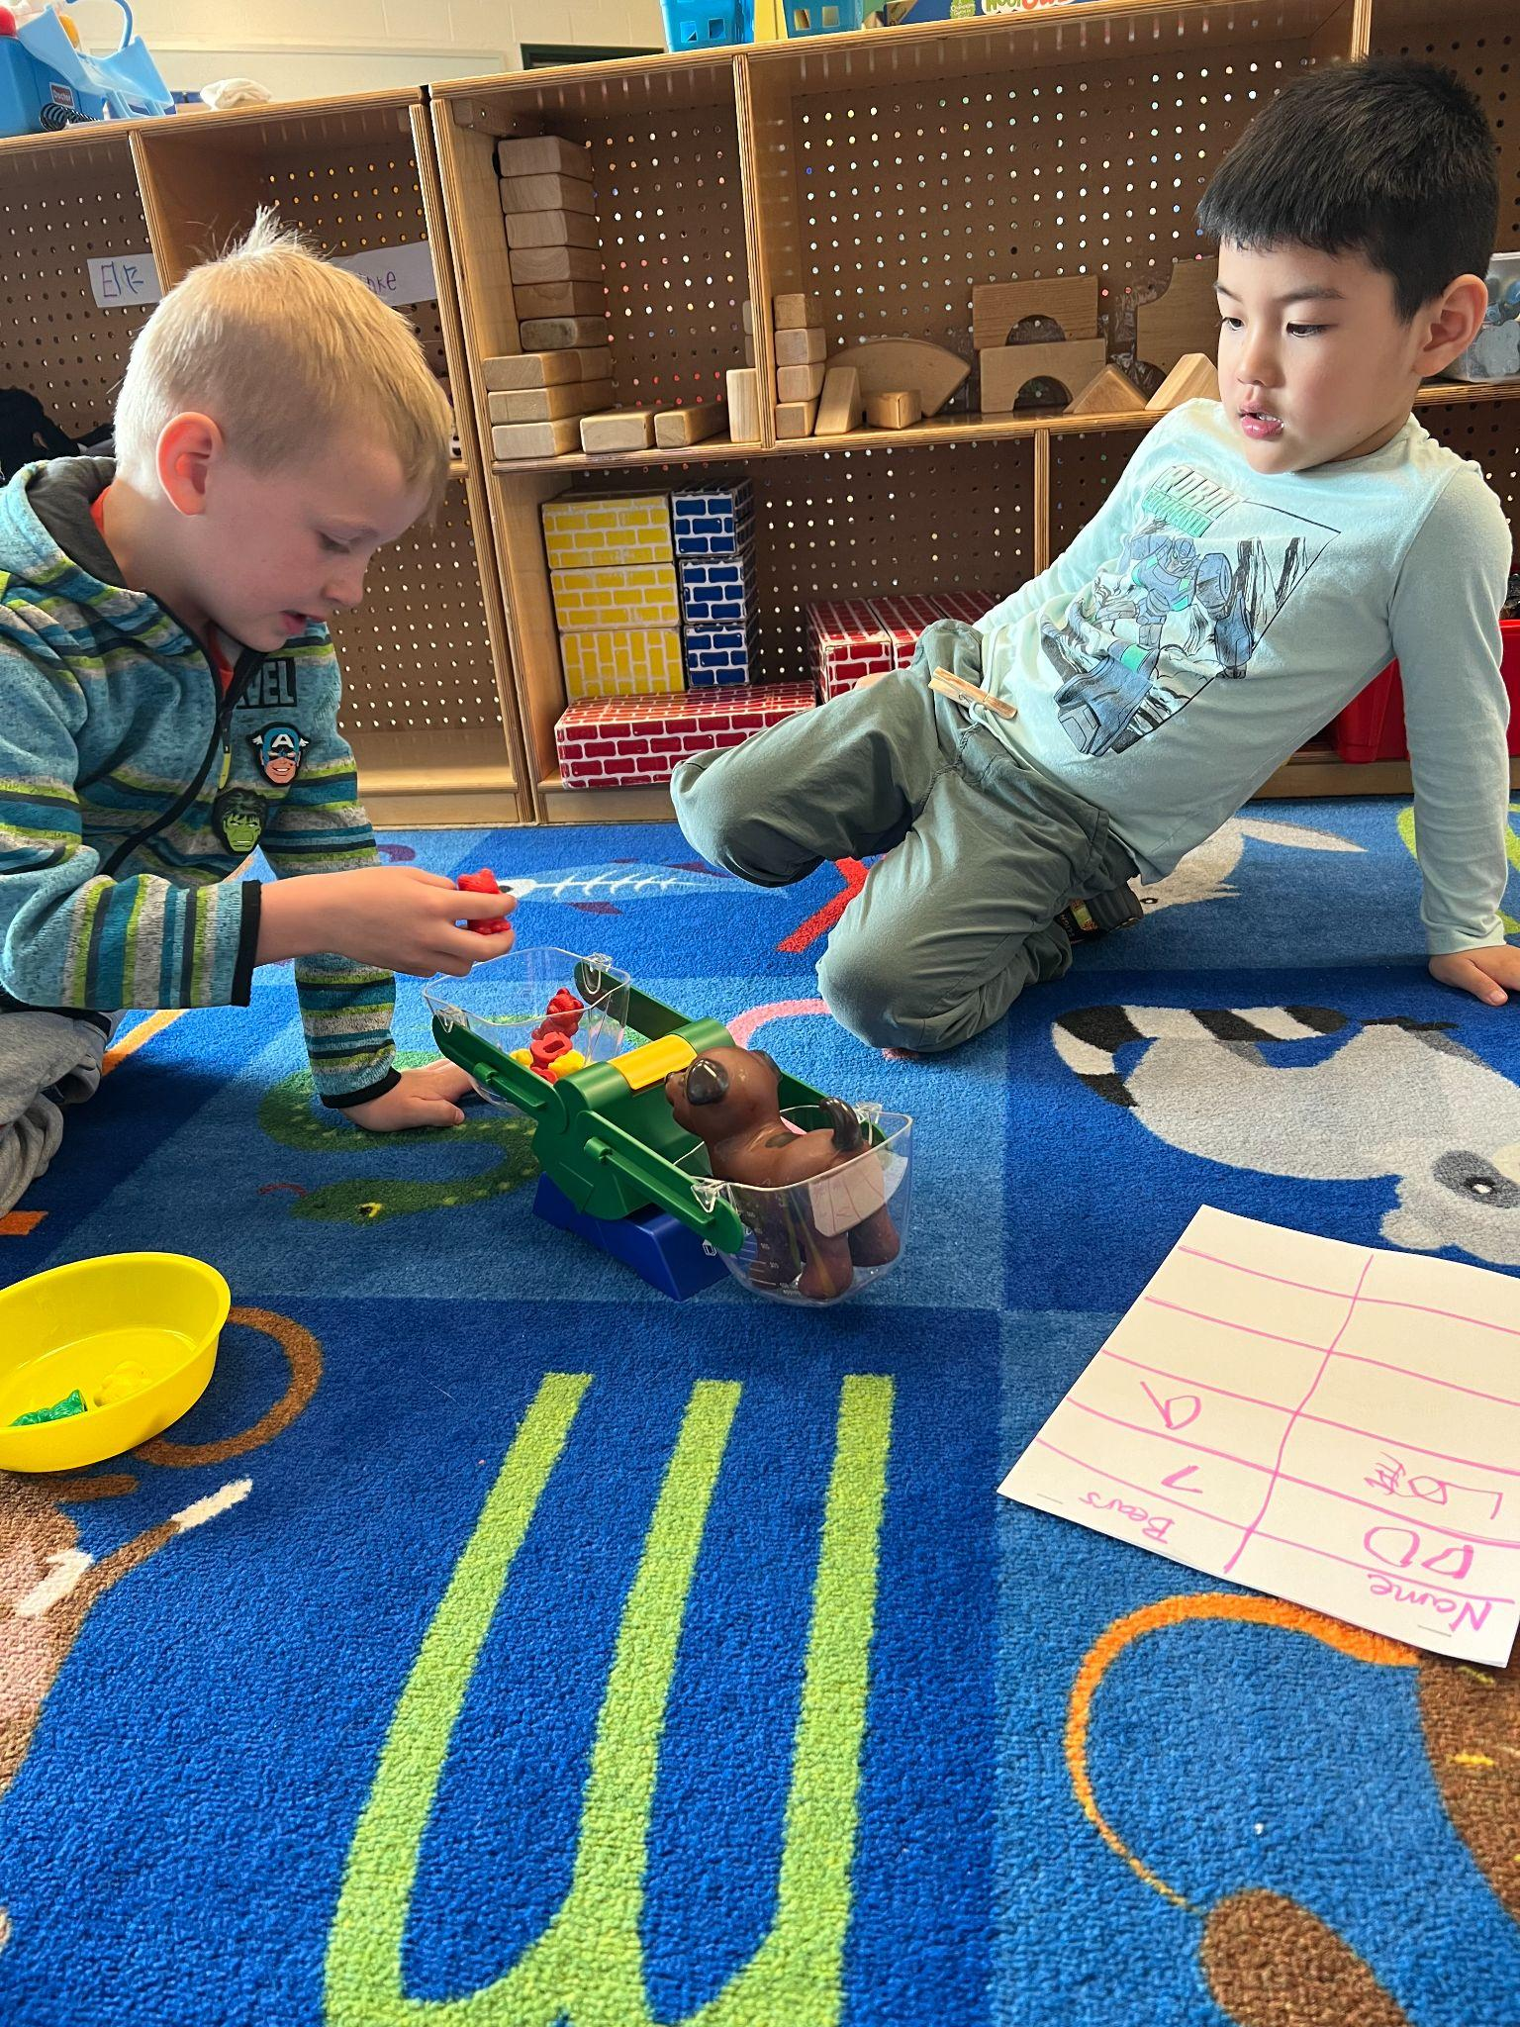
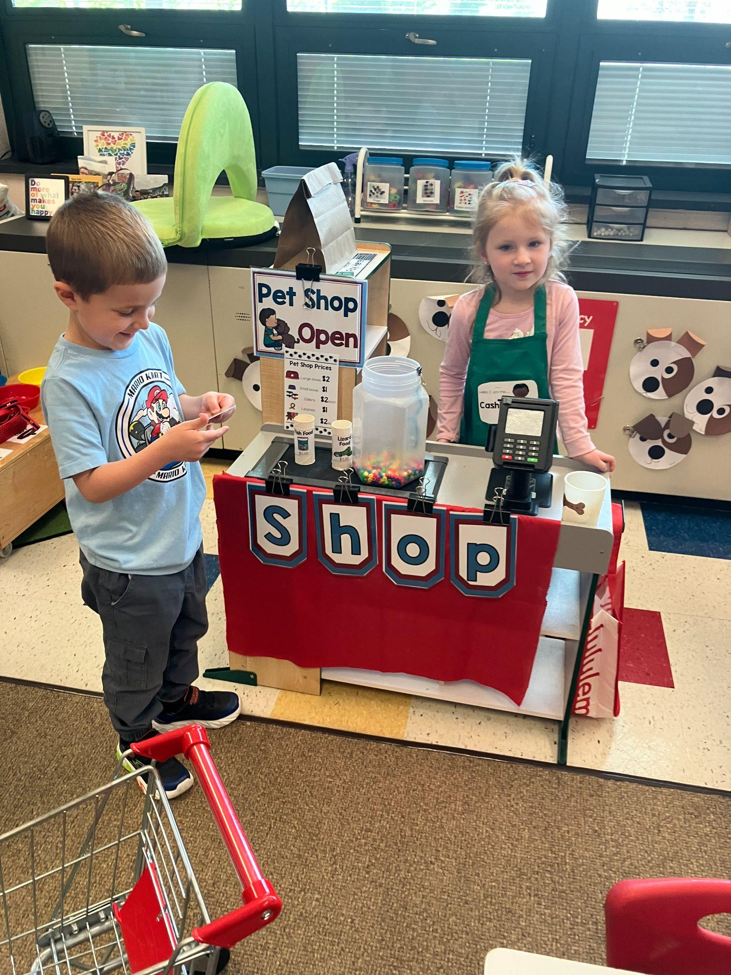
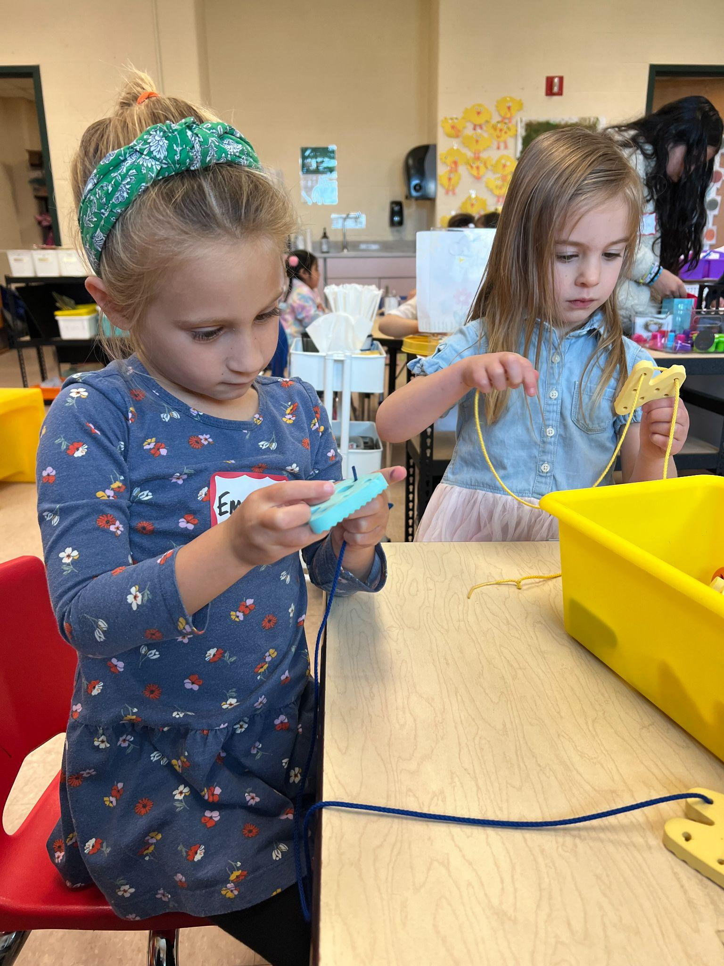
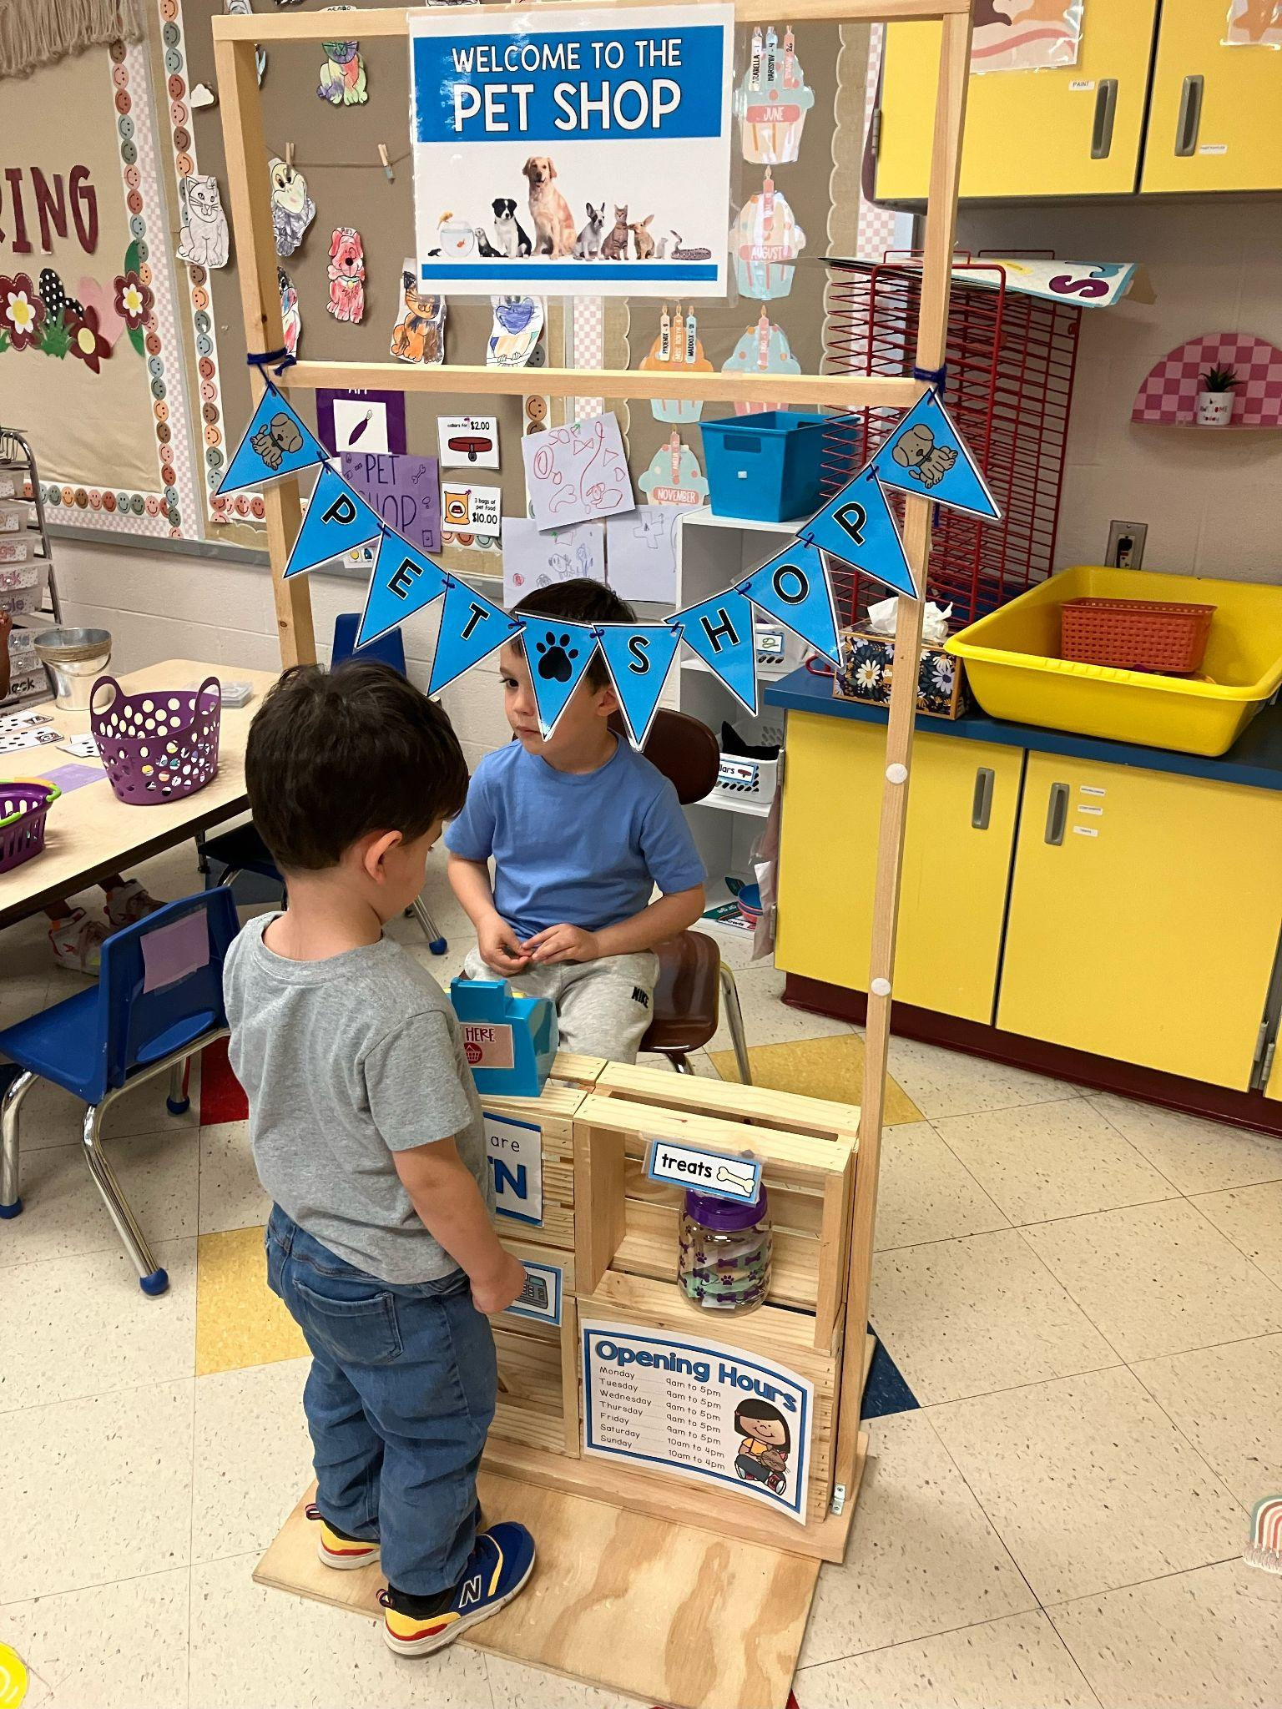
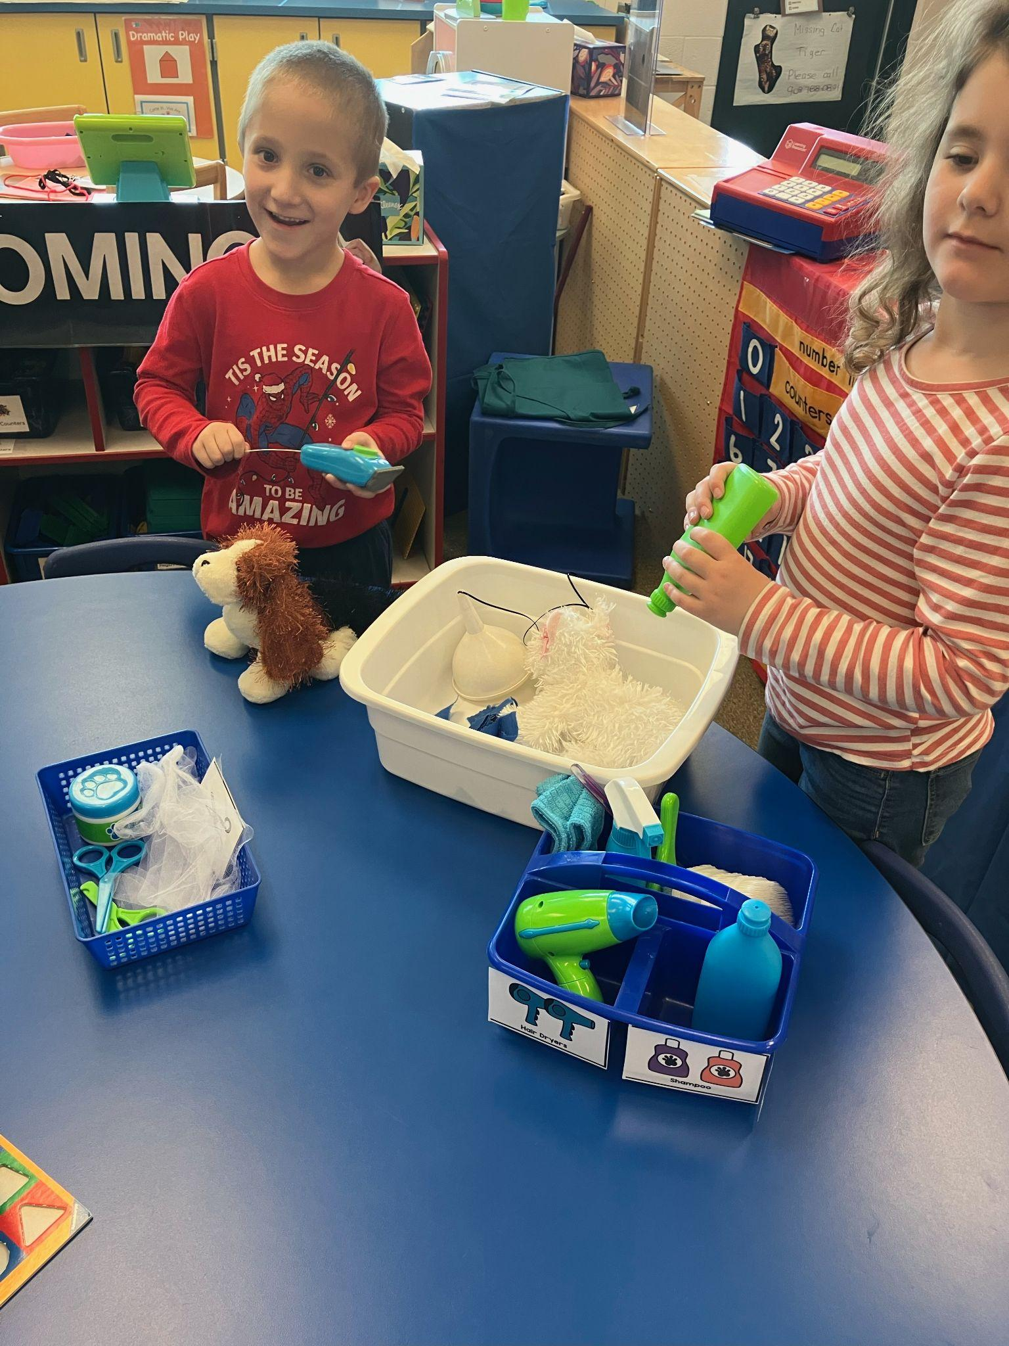
Life in Preschool!
Tools of the Mind Curriculum

Slide 8
Administrative Updates
We are currently hard at work with:
Preschool Family Handbook
Curriculum
Assessment

Slide 9
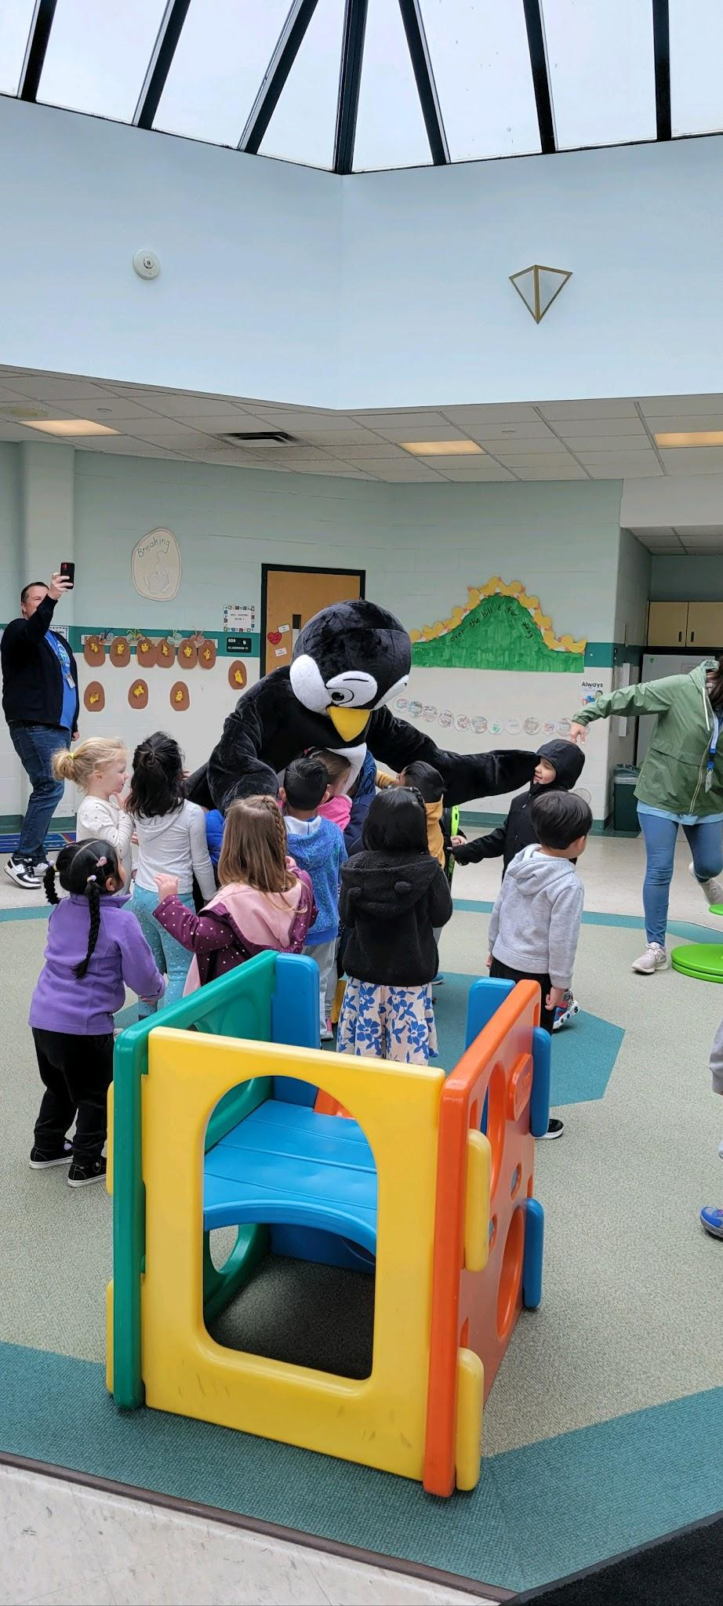
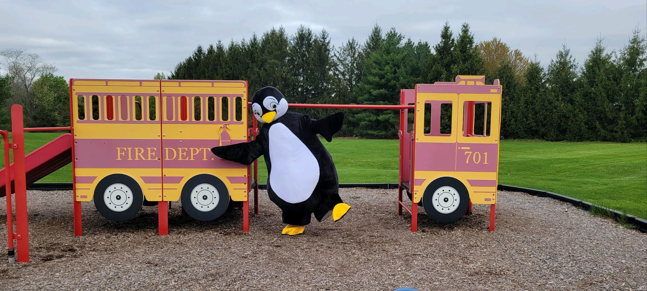
Preschool Unification
Pebbles (Spirit days May 9th and May 30th)
Communication
Penguin Post
Updated Website
Moving from good to great…input?

Slide 10
Thank you!
Next Meeting: Fall 2024
Topics: Leadership Roles and Bylaws
Examples of ECAC Committees:
Needs Assessment Committee
Transition Committee
Community Engagement Committee

